Slide 1
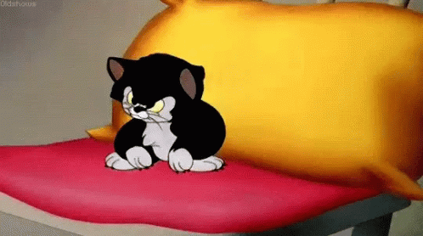
Understanding Difficult Behaviours

Slide 2
Introductions
Claire Tooth– EMHP (Education Mental Health Practitioner)
for Calderdale MHST (Mental Health Support Team).

Slide 3
Group agreement
A safe space to talk, share experiences and maintain confidentiality
Mobile phones on silent.
If you need a break/toilet, please feel free to have 5mins.
Any to add?

Slide 4
Aims
To understand what difficult behaviours are.
To understand why a child may be displaying difficult behaviours.
To learn practical ways to support your child when they are displaying difficult behaviours.
To be made aware of resources and services that can be accessed for further support.

Slide 5
Can you think of any behaviours you are experiencing or have experienced with your child?

Slide 6
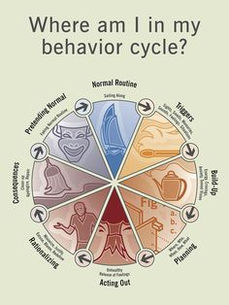
Behaviour Cycle
Notes:
How a difficult behaviour can build/ how triggers can impact (which leads on to next slide), how this can move on to acting out then rationalising the behaviour (so parents often expect an apology but the CYP feel this was a reasonable way to behave).

Slide 7
Identifying the behaviour’s purpose
All behaviour has a purpose. For some children it can be a way of communicating needs and feelings. A child may feel unwell, tired, hungry, thirsty or uncomfortable.
Biting may be due to pain in the mouth, teeth or jaw
Spitting may be related to a difficulty with swallowing or producing too much saliva
Ear slapping or head banging may be a way of coping with pain or communicating discomfort
Aggression may be due to adolescent hormonal changes
Busy, crowded environments may lead to verbal outbursts or even hiding/absconding.

Slide 8
Be patient, realistic and consistent
The behaviour generally won’t change overnight!
Tracking the behaviour in a diary may make it easier to notice small, positive changes.
Choose two behaviours to focus on at a time.
It’s important to continue with the strategies you are using.
Notes:
Using too many strategies at once may result in none of them working
Don’t worry if things seem to get worse before they get better
It’s important to continue with the strategies you are using
If patterns of behaviour have emerged from the diary, a behaviour plan can be put in place
It’s important that everyone involved has a consistent approach to the behaviour and regularly discusses how strategies are progressing

Slide 9
Support effective communication
Some children can have difficulties making themselves understood or understanding what’s being said to them and asked of them and understanding facial expressions and body language.
Even those who speak quite fluently may struggle to tell you something when they are anxious or upset.
This can cause considerable frustration and anxiety which may result in difficult and sometimes challenging behaviour.
Can you think of any examples?

Slide 10
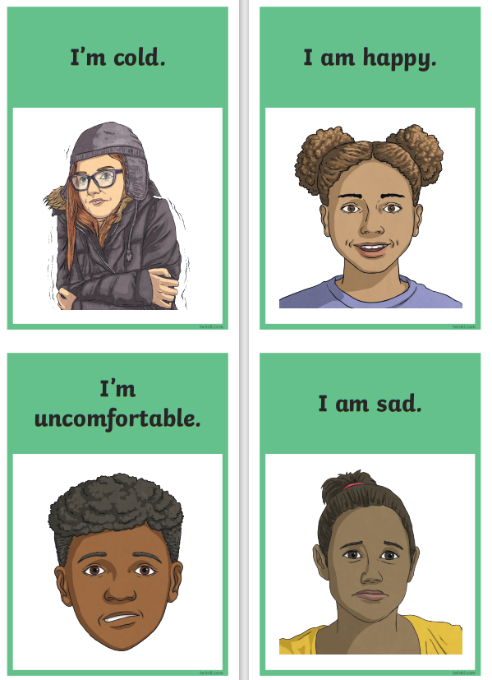
What can you do to help?
Speak clearly and precisely using short sentences.
By limiting communication, the young person is less likely to feel overloaded by information and more likely to be able to process what you say.
Some children may find it easier to process visual information. You can support them to communicate their wants and needs using pictures and symbols.
Taken from: 👉 Feelings, Wants and Needs Communication Aids - Twinkl

Slide 11
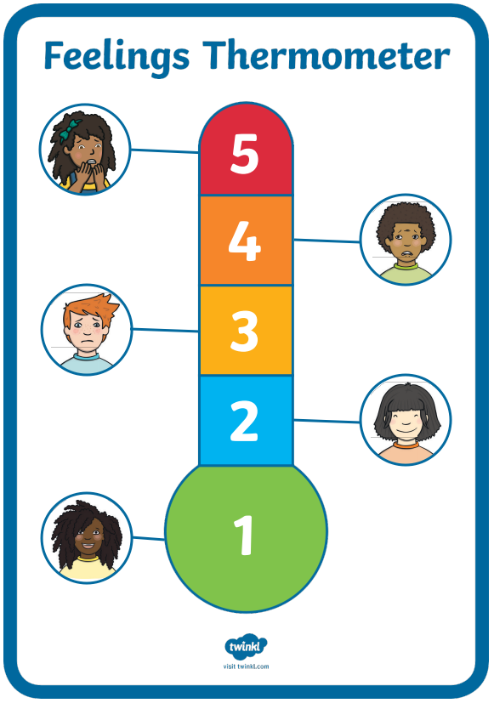
Help to identify emotions
Some children have difficulty with concepts such as emotions, but there are ways to turn emotions into more solid concepts.
You can use a traffic light system, visual thermometer or a scale of 1-5 to present emotions as colours or numbers.
If a child can identify that they’re getting angry then they can try to do something to calm themselves down, they can remove themselves from a situation or other people can see what is happening and take action.
Taken from: Feelings Thermometer Display | Feelings Poster PDF - Twinkl

Slide 12
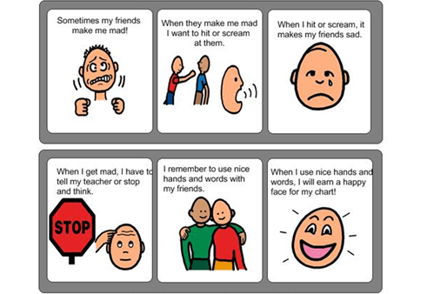
Social stories
Social stories can be a useful way of explaining how to manage a certain emotion.
A social story is a written or visual guide describing various social interactions, situations, behaviours, skills or concepts in terms of social cues, perspectives and common responses.
Taken from: Guide to Teaching Social-Emotional Skills With Social Scripts & Imitation (hes-extraordinary.com)

Slide 13
Praise and reward
Some children don’t understand the connection between their behaviour and a punishment.
Punishment won’t help them to understand what you want or help teach any new skills.
Using rewards and motivators can help to encourage a particular behaviour or a new coping strategy.
Try to give praise and rewards immediately and in a way that is meaningful to your child. Be specific about what the praise is for.
Notes:
Even if the behaviour or task is very short, if it is followed by lots of praise and a reward the young person can feel positive about their behaviour, coping strategy or skill.
Some like verbal praise, some may prefer physical praise like a sticker on their chart or extra time doing their favourite activity.

Slide 14
Offer a safe space or ‘time out’
A safe space or time out can be a way to calm down, especially if environmental factors are causing distress.
Support your child in choosing their safe space or safe activity. Ensure it is something that can be easily accessed.
You may want to discuss with them about taking their safe activity out and about with them, so they know they have this as a choice.
Can you think of some examples of safe activities you could use with your child?
Notes:
This could be in a familiar place, like their bedroom or doing a calming activity.
Ask for examples of safe activities they could use that could also be taken out with them (challenging behaviour can often be most difficult when in public, so having this secure at home before going out will allow parents/carers to feel more secure).

Slide 15
Build in relaxation
Build in opportunities for relaxation, and engaging in favourite activities, into the daily routine.
Relaxing activities could include looking at a bubble, smelling essential oils, listening to music, massages or swinging on a swing.
Difficult behaviour can often be diffused by an activity that releases energy or pent-up anger or anxiety.
This might be punching a punch bag, bouncing on a trampoline or running around the garden.
Notes:
These could be included on the visual timetable.
You can find lots of great techniques and tips for meditation and mindfulness on the Headspace website - Meditation and Sleep Made Simple - Headspace

Slide 16
Generalise and maintain skills
Some children can find it difficult to transfer new skills they have learnt from one situation to another.
Find opportunities to use new skills or coping strategies in different situations and check that skills haven’t been forgotten.
If you have used strategies successfully in the past, it might help to revisit them from time to time.
You may also need to use them during periods of stress, illness or change when old behaviours can return.
Notes:
Be consistent with the strategies you use - make sure they can be applied in different settings/ circumstances and share this with other people involved in CYP's life (school/ childminders/ extended family who may have a caring role)

Slide 17
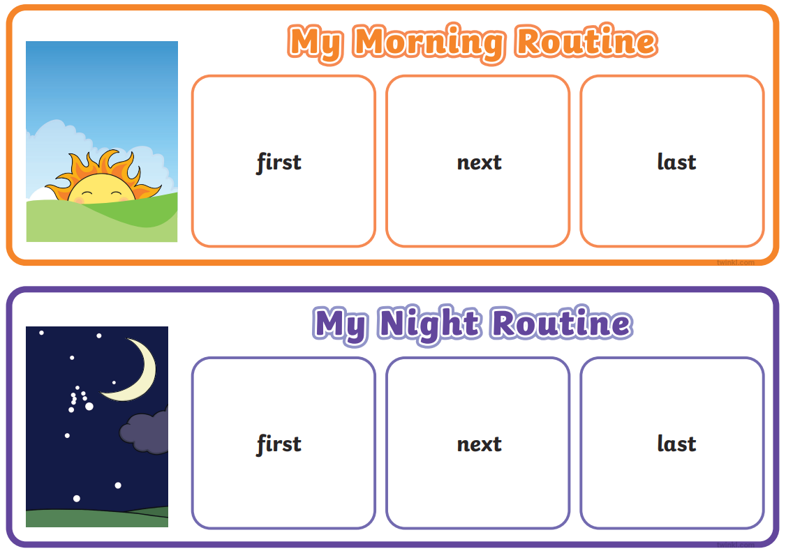
Managing change and transition
Some children can find it difficult to cope with change.
Sequencing can be difficult – time and understanding time can be difficult for some young people.
You may find that behavioural difficulties occur more in transition times between activities.
Using a visual timetable can often help the young person to see what will be happening throughout the day.
Taken from: Morning Routine for Kids - Daily Routine Sorting Activity (twinkl.co.uk)
Notes:
These changes can be a temporary change or something more permanent.
Sequencing - where you are putting what is happening in a day in a logical order in your mind.
It is important where possible to prepare in advance for what the change is likely to involve

Slide 18
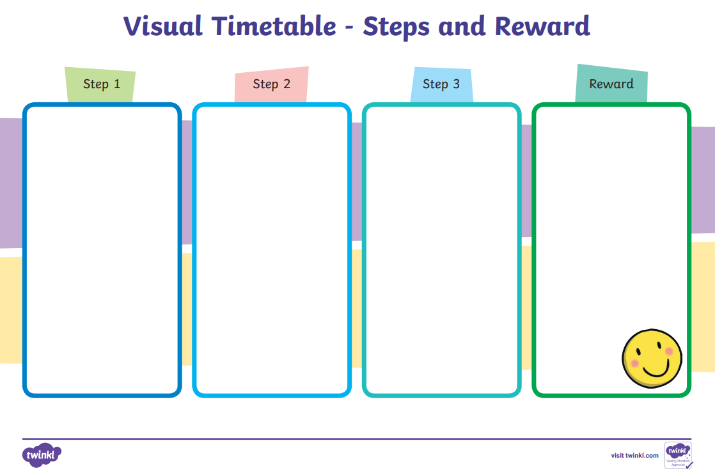
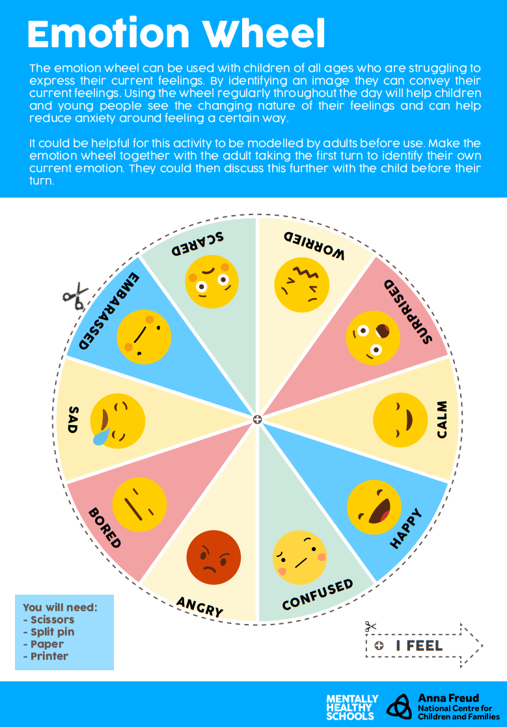
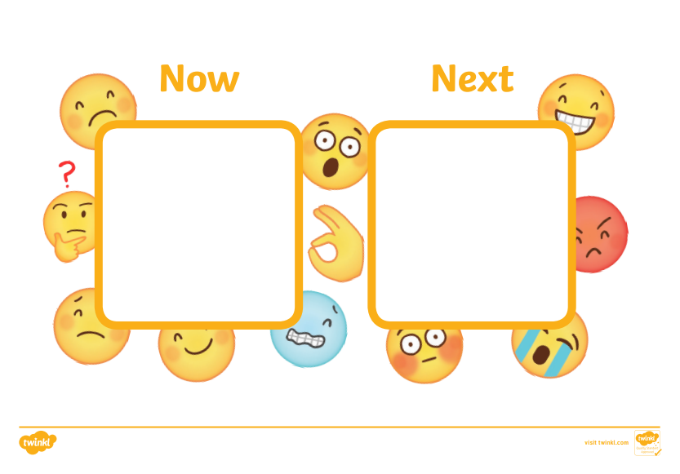
Resources
Taken from: Printable Routine Chart | Reward Charts | Twinkl – Twinkl; 😊 Emoji-Themed Now and Next Visual Aid (teacher made) (twinkl.co.uk); emotion-wheel.pdf (mentallyhealthyschools.org.uk)

Slide 19
What to do if more support is needed?
Look at the Open Minds website – this has lots of great resources and tips for young people.
The Open Minds Partnership includes different services in Calderdale which offer different kinds of support:
Time Out – guidance about emotional wellbeing, managing worries and looking after yourself. 10-19 years.
Kooth – online, anonymous counselling. 10-25 years.
The Brunswick Centre – advice and support for those who identify or are questioning their gender and/or sexual identity.
Calderdale Young Carer’s Service – advice and guidance on being a young carer. 8-18 years.
Branching Out – specialist support and advice around drugs and alcohol. 10-21 years.
The Brew Project – 1:1 support sessions or 1:1 ‘walk and talk’ service. 5-17 years.
Calderdale School Nursing Team – help to manage long and short-term conditions in education settings for children and young people. 5-19 years.
Open Minds (CAMHS) – advice and signposting, 1:1 specialist mental health support. 5.18 years.

Slide 20
SilverCloud: Digital Mental Health Support
Currently, SilverCloud offers children and young people five programmes of mental health support. Three for young people and two for parents/carers of children and young people.
Free, minimal wait times, early intervention for mild/moderate anxiety/low mood
Space From Anxiety –This programme is an online intervention aimed at alleviating psychological distress arising from anxiety related symptoms. This programme has been developed to help young people aged 14 years and over manage these feelings and the causes of them, ultimately offering welcome space from anxiety.
(NEW) Space From Low Mood – Another online programme that has been designed to relieve the symptoms of low mood in young people by focusing on developing more flexible ways of thinking, increasing awareness and understanding of emotions and understanding their mood, as well as their triggers. This is aimed at supporting young people 14 and above.
(New) Space from Low mood & Anxiety - The Space from Low Mood & Anxiety programme has been designed to relieve the symptoms of low mood and anxiety in young people by focusing on developing more flexible ways of thinking, increasing awareness and understanding of emotions and understanding their mood, as well as their triggers, and warning signs of low mood and anxiety. This is aimed at young people 14 and over
Supporting an Anxious Child (4-12 years) and Supporting an Anxious Teen (13 plus) are online interventions for parental use alongside their child. The programmes are based on CBT and built in conjunction with leading clinical experts. These programmes provide psychoeducation, tools and activities in a safe confidential space to help parents support their children or teens.
For more information please contact silvercloud@northpoint.org.uk or 01422 300 001. Referrals can be made here:
Silvercloud | Northpoint Wellbeing - Open Minds (CAMHS) (openmindscamhs.org.uk)
Notes:
Links/contacts at the end of the presentation.

Slide 21
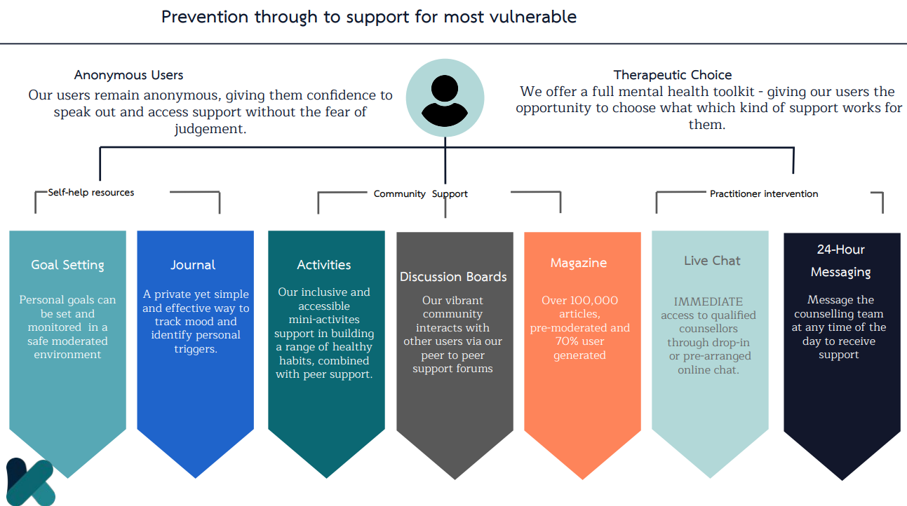
Kooth

Slide 22
Night Owls
Night OWLS – a new service for young people in West Yorkshire. - YouTube

Slide 23
Q&A
Any questions?
Review aims of the session.

Slide 24
Useful services
The Family Support Team (FST) - work with families with children aged 0-19. They offer confidential parenting and emotional support to parents in addition to group support and training. The team cover areas such as behaviour, family dynamics and relationships. They also provide parenting programmes and advice on accessing local services.
This support can be accessed by contacting your local Children’s Centre and asking to speak to a member of the Family Support and Outreach Team or by enquiring about your nearest Family Support Drop-in. Their contact details are as follows:
Central Halifax (Jubilee Children’s Centre) - 01422 342552 http://www.childrencentres.co.uk/index.php/our-centres/jubilee-children-centre
Upper Valley (Todmorden Children’s Centre) - 01706 399970 http://www.childrencentres.co.uk/index.php/our-centres/todmorden-children-s-centre
North & East Halifax - 01422 251090 http://surestartchildrenscentresnhp.org.uk/
Lower Valley - 01422 251090 http://surestartchildrenscentresnhp.org.uk/

Slide 25
Useful services
Newbold Hope - Newbold Hope works with parents and professionals to reduce difficult and dangerous behaviour in children with a disability or an additional need. We also work to change people’s perceptions about this issue, so that the blame, judgment, and shame that is so often, and very unfairly, directed at this group of children and their parents is also significantly reduced and replaced with compassionate understanding, help, and support. Online course, webinars and resources are available at the website www.newboldhope.org
The Challenging Behaviour Foundation - We provide practical information for families and professionals about understanding and supporting children, young people and adults whose behaviour challenges. Our Family Support Workers can offer individual support and information over the phone and by email. We also offer peer-to-peer support through our Carers’ Catch-Ups, and email networks for family carers and for professionals. We offer a range of workshops to families and professionals, co-delivered by a professional trainer and a family carer trainer. Our workshops have been found to reduce challenging behaviour and have positive outcomes for families and professionals who attend. www.challengingbehaviour.org.uk

Slide 26
Useful links
Open Minds website – advice and resources for young people, parents and schools.
www.openmindscalderdale.org.uk
Mentally Healthy Schools website by Anna Freud – resources for young people and schools.
www.mentallyhealthyschools.org.uk
Kooth – safe, online, anonymous counselling for 10—25 year olds.
www.kooth.com
Time Out – simple guidance around emotional wellbeing, managing worries and looking after yourself. 10 – 19 years.
www.timeoutcalderdale.co.uk

Slide 27
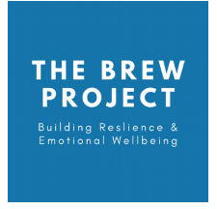
Useful links
The Brunswick Centre – specialist advice and support to those who identify or are questioning their sexual and/or gender identity.
Contact details: 01422 341 764 or info@thebrunswickcentre.org.uk
The Brew Project – 1:1 support sessions with a wellbeing officer or a 1:1 walk and talk service. 5-17 years.
Contact details: 01422 730015 or support@invictuswellbeing.com
Branching Out – specialist support and advice around drugs and alcohol. 10-21 years.
Contact details: 01422 415550
Calderdale School Nursing Team - help to manage long and short-term conditions in education settings for children and young people. 5-19 years.
Contact details: 030 3330 9974 (duty line) or online referral via online referral form

Slide 28
Useful links
Calderdale Young Carer’s Service – advice and guidance on being a young carer. 8-18 years.
Contact details: 01422 261208 or www.calderdale.gov.uk/ycs
Noah’s Ark – therapeutic services for young people and bereavement support group. Paid service.
www.noahsarkcentre.org.uk
Open Minds (CAMHS) – signposting, advice and mental health interventions for children aged 5-18 years. Also offers consultation, support, advice, training and referral guidance to parents/carers, young people and professionals.
Contact details: 01422 300 001. www.openmindscamhs.org.uk

Slide 29
Thank you for listening!
Notes:
Please complete the feedback forms!
https://forms.office.com/r/yhLC73Aszq

