Slide 1
Supporting Transition
Image from: School by Owen Chikazawa on Dribbble

Slide 2
Introductions
Bex Brooksbank – Clinician and Supervisor
Claire Tooth– EMHP (Education Mental Health Practitioner)
Calderdale Mental Health Support Team
1:1 interventions for children and young people
Whole School Approach to support schools to work with children and families
Advice and signposting to other services

Slide 3
Aims
To understand the impact of transition.
To understand some of the changes to your child’s development.
To know how you can support the transition to secondary school.

Slide 4
What is transition?

Slide 5
Change
There are two different types of change:
Discontinuous – a sudden, unplanned change.
Focal – where the change is planned and it is the only change.
It is important that the transition to secondary school is a focal change for your child.
Taken from: Change It Good But Its Not Easy Pictures, Photos, and Images for Facebook, Tumblr, Pinterest, and Twitter (lovethispic.com)

Slide 6
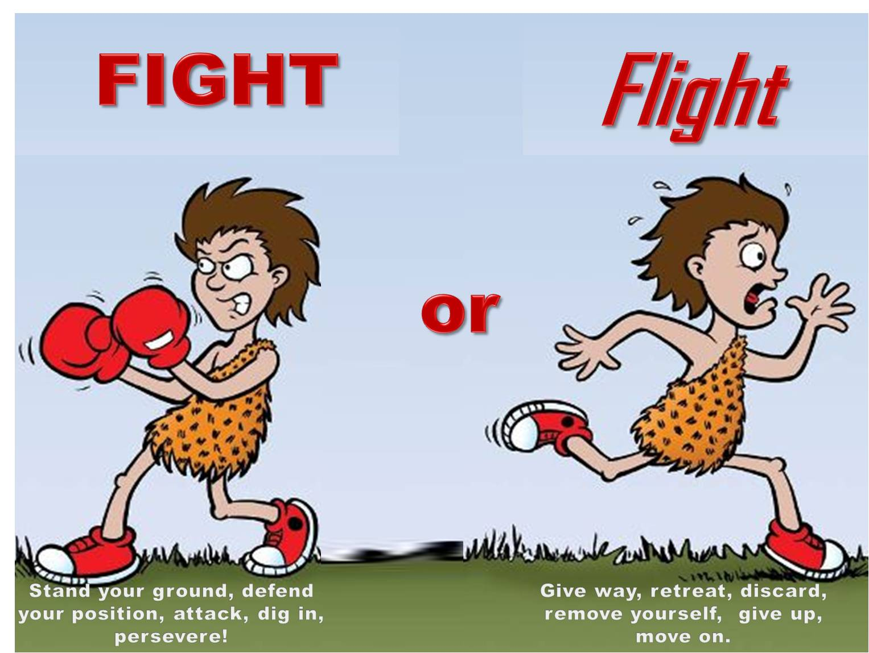
Anxiety
Worry is normal – anxiety is when we cannot let go of that worry and we find ourselves worrying about lots of different things, all the time.
Anxiety is our body’s defense mechanism and helps to keep us safe – our brain reacts to dangerous/stressful situations and prepares our bodies to react by releasing adrenaline. This is called the fight-flight-freeze response.

Slide 7
Spotting the warning signs…
Some warning signs of anxiety to look out for in young people include:
Physical symptoms of anxiety eg. tummy ache, etc.
Struggling to separate from parent/carer, presenting as emotional
Asking lots of questions to get reassurance, eg. about work, timetable, plans.
Avoiding/refusal to talk about school/going to school
Repeated checking, eg. that work is correct, that they have everything
Worry about what other people think, trying to people please, perfectionist
Difficulty concentrating, fidgeting
Changes to appetite and sleep
Image from: Images Bee GIF - Find & Share on GIPHY

Slide 8
Teenage Brain!
Children are going through a period of hormonal change and neurological changes – the brain is ‘pruning’ itself and getting rid of pathways that are not used.
Synaptic pruning results in a loss of paths - these pathways are within the brain and link emotions and thoughts. If a child witnesses trauma on a regular basis this path will be very strong, as opposed to a child who is praised regularly where this pathway would be strong.
Image from: Brainwave by Alana Brajdic on Dribbble

Slide 9
Brain changes and behaviour
Many behavioural/emotional changes at this time are due to brain changes as opposed to hormonal issues.
Feeling confused or uncertain – finding it difficult to make decisions
Not knowing what to think
Irritability
Mood swings
Prioritising fun, new things, motivated by praise and getting rewards
Sleep difficulties
Increased risk taking
Sensitivity to stress

Slide 10
The Social Brain
The prefrontal cortex plays an important part in social relationships, but we know this develops later on in adolescence.
Empathy skills and facial recognition skills are still developing.

Slide 11
The Social Brain
An imaginary audience!
Egocentrism
More influenced by peers
Less likely/willing to take adult guidance
Avoiding social risks can be more important than other risks
Better at recognising emotions of others
Able to evaluate social situations
Increased pro-social behaviour
Better at thinking about consequences of behaviour and how this may impact others

Slide 12
What does a successful transition look like?
Research shows that the signs of a successful transition are:
Making new friendships
Maintaining good self-esteem and confidence
Showing an interest in the school and schoolwork
Getting used to the new routines and school organisation
Experiencing continuity in learning

Slide 13
Transition Outcomes
A positive transition can lead to:
Increased friendships
Positive self-esteem
School motivated
School interested
Confidence building
Adaptation to new routines
Academic success at own level
A negative transition can lead to:
Depression
Eating disorders
Substance misuse
Risky/anti-social behaviour
Reduced academic achievement
School refusal

Slide 14
Transition
What is important to young people:
Will I be liked?
Having friends and siblings at a different school or in a different class.
The distance from school to home.
What facilities/provisions the school has.
What may worry young people:
Leaving friends and teachers.
Bullying
Making new friends
Getting lost
Amount of homework
Older and bigger children
The school being bigger

Slide 15
How can you support transition?
The Anna Freud Centre identified four ways for you to support your child through the transition to secondary school. They are:
Helping them to explore their feelings
Helping them connect to their school
Building friendships and relationships
Empowering – by building their confidence and independence

Slide 16
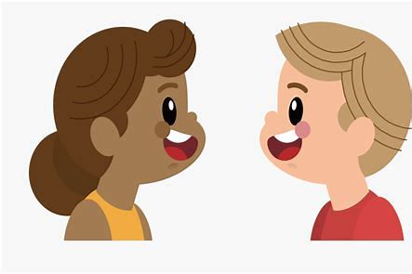
Explore
Help your child to explore their thoughts and know that they can talk about their feelings
Mark the end to their primary school experience
Keep talking to your child and allow them to ask any questions, talk about any worries they may have, any possible misunderstandings
Discuss what they are looking forward to and what they are worried about

Slide 17
Connecting
Help your child to start connecting with their new school
Meet key members of staff if possible and know how best to communicate with the school
Help your child plan their journey to school and practice this with them if needed
If your child is struggling with their new school (after a few weeks), then get in touch with the school to discuss this

Slide 18
Building friendships and relationships
Help your child to start thinking about how to approach meeting new people and how to start a conversation with them
It can be helpful to encourage them to join some extracurricular activities
If possible, consider planning activities over the summer to allow your child to meet up with others

Slide 19
Empowering
Empower and support your child to start being more independent and to take on small responsibilities in the home to build their confidence and independence
Give your child lots of praise and notice things that they are doing well

Slide 20
Other tips…
Share information about the change with the young person
Organise/attend visits
Allow time to discuss worries
Encourage your child to pack things/have a checklist
Consider the young person’s self-esteem
Plan the first days/weeks together
Involve them in the preparations for secondary school
Be patient!
Provide distractions

Slide 21
Some resources for supporting the transition…

Slide 22
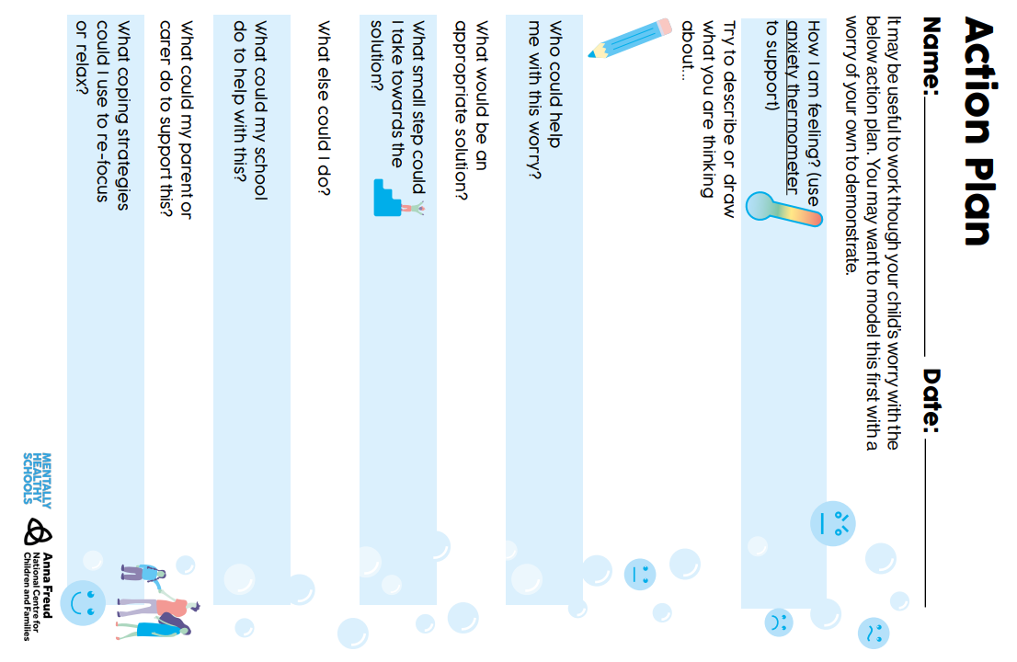
Action Plan
Agree on an action plan!
Encourage your child to describe the worry, to identify who could help them with it, solutions and coping strategies.
Taken from: rebuild-and-recover-anxiety-tools-for-parents.pdf (mentallyhealthyschools.org.uk)

Slide 23
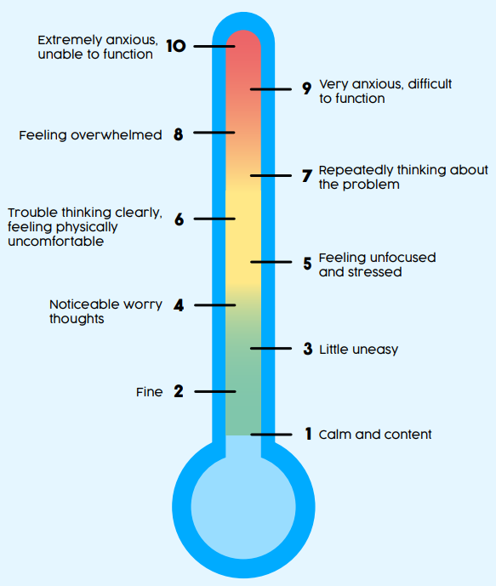
Anxiety Thermometer
All children are different and some children find it difficult to talk about their emotions, especially younger children.
Use an anxiety thermometer with your child to help them to describe how they are feeling when they are anxious and to rate the intensity of the feeling.
Taken from: Anxiety thermometer (mentallyhealthyschools.org.uk)

Slide 24
Positives and Negatives of Change
Encourage your child to explore how they feel about the transition to high school.
Discuss the upcoming change with them and ask them to identify the positives and negatives of the change – hopefully the positives will outweigh the negatives!
Taken from: What Are the Positives and Negatives of a Change? Worksheet (twinkl.com)

Slide 25
Self-Soothe Box
A self-soothe box is a great toolkit, filled with things that ground and relax your child when things are tough.
Support your child to find objects for all of the senses. Agree on where it will be kept, when it will be needed.
For example: fidget toys, favourite sweets/chocolate, water bottle, mindful colouring, relaxing music, hand lotion, fluffy socks.
Notes:
Hampshire CAMHS - Make Your Own Self Soothe Box - YouTube

Slide 26
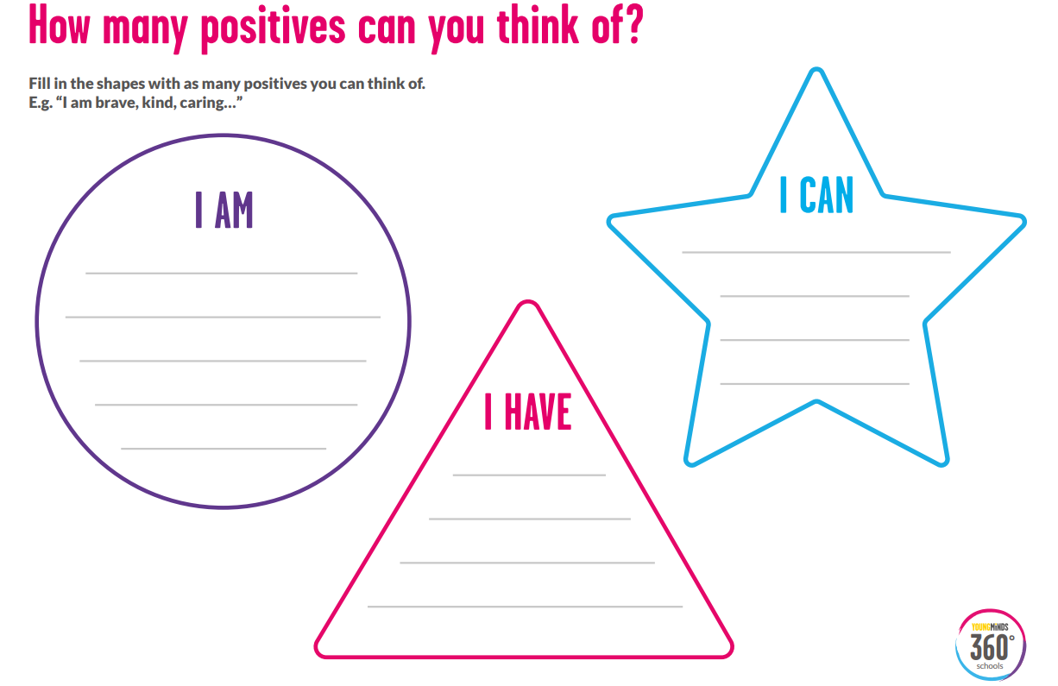
Positive Thinking!
Encourage positive thinking!
When things are changing or we are worried about something, sometimes all we can see are the negatives and we can think of the worst case scenarios. Encourage your child to think of the positives too and practice positive self-talk.
For example:
I am strong.
I have lots of friends.
I can cope with this.
Taken from: how-many-positives-360-activity.pdf (youngminds.org.uk)

Slide 27
Other suggestions…
Worry time – set a time for worrying when you and your child will discuss what is worrying them. This helps your child learn to postpone and sit with their worries.
Mindfulness and breathing exercises
Exercise
Preparation
Routine
Sleep
Reassurance

Slide 28
What to do if more support is needed?
Look at the Open Minds website – this has lots of great resources and tips for young people.
The Open Minds Partnership includes different services in Calderdale which offer different kinds of support:
Time Out – guidance about emotional wellbeing, managing worries and looking after yourself. 10-19 years.
Kooth – online, anonymous counselling. 10-25 years.
Barnardo’s Positive Identities – advice and support for those who identify or are questioning their gender and/or sexual identity. 8-25 years.
Calderdale Young Carer’s Service – advice and guidance on being a young carer. 8-18 years.
Branching Out – specialist support and advice around drugs and alcohol. 10-21 years.
The Brew Project – 1:1 support sessions or 1:1 ‘walk and talk’ service. 5-17 years.
Calderdale School Nursing Team – help to manage long and short-term conditions in education settings for children and young people. 5-19 years.
Open Minds (CAMHS) – advice and signposting, 1:1 specialist mental health support. 5.18 years.

Slide 29
What to do if more support is needed?
Silvercloud – Open Minds (CAMHS) is now able to offer access to free on-line support for young people, parents and carers.
This support is free, accessible and involves minimal waits. A ‘Supporter’ from Open Minds (CAMHS) will provide on-line encouragement, guidance and advice and help monitor risk and effectiveness.
In order to benefit from Silvercloud support, young people (aged 14+) or their parents/carers will need access to a device (smartphone, tablet and laptop) and be IT literate. This support is not suitable for young people where there are significant risk concerns.
Supporting an Anxious Child and Supporting an Anxious Teen are online interventions based on CBT and built in conjunction with leading clinical experts. The programmes provide psychoeducation, tools and activities in a safe confidential space to help parents support their children or teens.
For more information please contact silvercloud@northpoint.org.uk or 01422 300 001. Referrals can be made here: Silvercloud | Northpoint Wellbeing - Open Minds (CAMHS) (openmindscamhs.org.uk)
Notes:
Links/contacts at the end of the presentation.

Slide 30
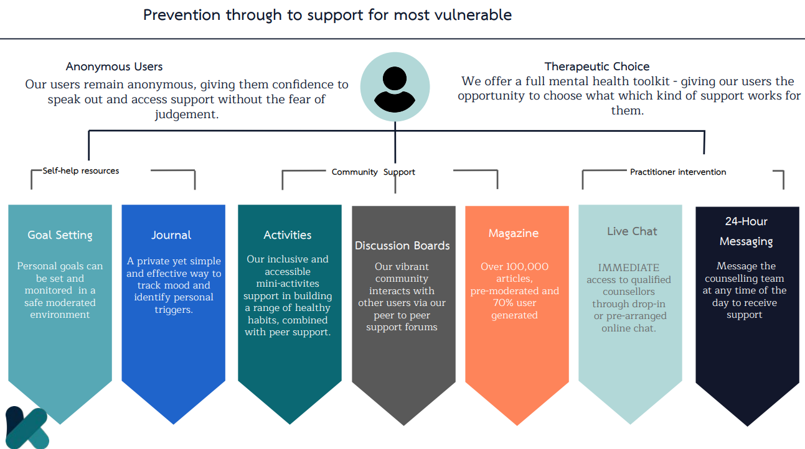
Kooth

Slide 31
Night Owls

Slide 32
Q&A
Any questions?
Review aims of the session.
Image from: Question Mark by Joel Plosz on Dribbble

Slide 33
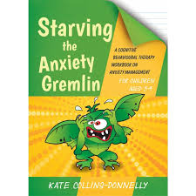
Useful resources
‘The Huge Bag of Worries’ by Virginia Ironside
‘Starving the Anxiety Gremlin’ by Kate Colling-Donnelly
‘Think Good, Feel Good’ by Paul Stallard
‘What To Do when You Worry Too Much’ by Dawn Huebner
‘Supporting children’s transition to secondary school: Guidance for
parents and carers’ by Anna Freud Centre (Supporting children's transition to secondary school | Childrens mental health and wellbeing in schools | Anna Freud Centre)

Slide 34
Useful apps
The Worry Box (Managing Worries) Put your worries away in a box! While that statement seems too good to be true, this app’s idea is to help you deal with and manage your worries. You keep a personal diary in the app where you input your worries. The Worry Box then helps you decide if the worry is unimportant, important, controllable, or uncontrollable. Depending on the worry, the app will give you techniques to help manage it, like next steps or coping statements to tell yourself.
Smiling Minds (Mindfulness) The smiling mind is a mindfulness app that supports positive mental health and wellbeing. The programs education app is designed for both primary and secondary aged children.
Stop, Breathe & Think Kids (5-10 y/o emotional literacy/sleep) Only for Apple devices currently, focusses upon emotional literacy, calmness and sleep. App has an activity focus and uses emoticons and games to help young people
Mindful Gnats is an app designed to teach young people simple mindfulness and relaxation skills. It can be used to help mindfulness practice when playing the Mindful Gnats desktop game (see www.peskygnats.com for details) or as a stand alone aid to mindful practice. These skills can help to reduce stress, and improve awareness of your body, mind and world.
Headspace – mindfulness app with a kids section.

Slide 35
Useful links
Open Minds website – advice and resources for young people, parents and schools.
www.openmindscalderdale.org.uk
Mentally Healthy Schools website by Anna Freud – resources for young people and schools.
www.mentallyhealthyschools.org.uk
Kooth – safe, online, anonymous counselling for 10—25 year olds.
www.kooth.com
Time Out – simple guidance around emotional wellbeing, managing worries and looking after yourself. 10 – 19 years.
www.timeoutcalderdale.co.uk

Slide 36
Useful links
Barnardo’s Positive Identities – specialist advice and support to those who identify or are questioning their sexual and/or gender identity. 8-25 years.
Contact details: 01422 371993 or PositiveIdentities@barnardos.org.uk
The Brew Project – 1:1 support sessions with a wellbeing officer or a 1:1 walk and talk service. 5-17 years.
Contact details: 01422 730015 or support@invictuswellbeing.com
Branching Out – specialist support and advice around drugs and alcohol. 10-21 years.
Contact details: 01422 415550
Calderdale School Nursing Team - help to manage long and short-term conditions in education settings for children and young people. 5-19 years.
Contact details: 030 3330 9974 (duty line) or online referral via online referral form

Slide 37
Useful links
Calderdale Young Carer’s Service – advice and guidance on being a young carer. 8-18 years.
Contact details: 01422 261208 or www.calderdale.gov.uk/ycs
Noah’s Ark – therapeutic services for young people and bereavement support group. Paid service.
www.noahsarkcentre.org.uk
Open Minds (CAMHS) – signposting, advice and mental health interventions for children aged 5-18 years. Also offers consultation, support, advice, training and referral guidance to parents/carers, young people and professionals.
Contact details: 01422 300 001. www.openmindscamhs.org.uk

Slide 38
Thank you for listening!
Notes:
Please complete the feedback forms!

